Slide 1

Find and book reliable, affordable and quality dog care in your area.

Slide 2
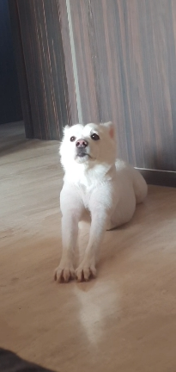
What Is PetConn?

Slide 3
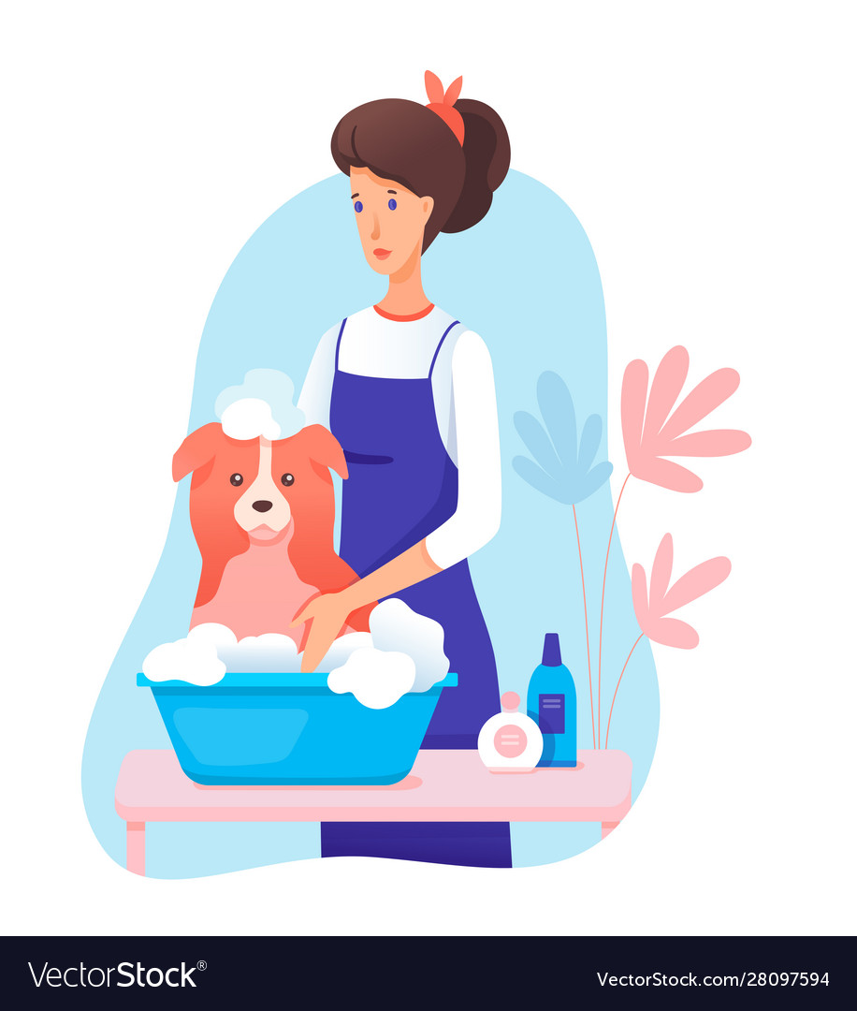
What is PetConn?
Concretely, PetConn provides a marketplace for people to buy and sell pet-care services.
Notes:
Please make it interesting to read n look at. Make it eye catching and write in bullet points.

Slide 4
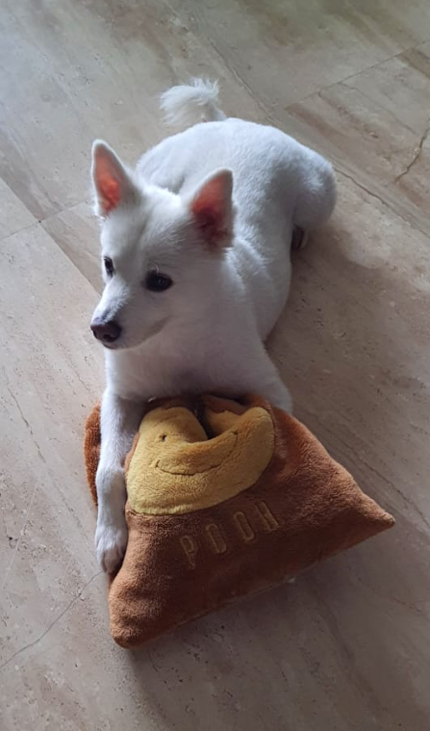
Market Research
Notes:
Dont write this. Give heading market research

Slide 5
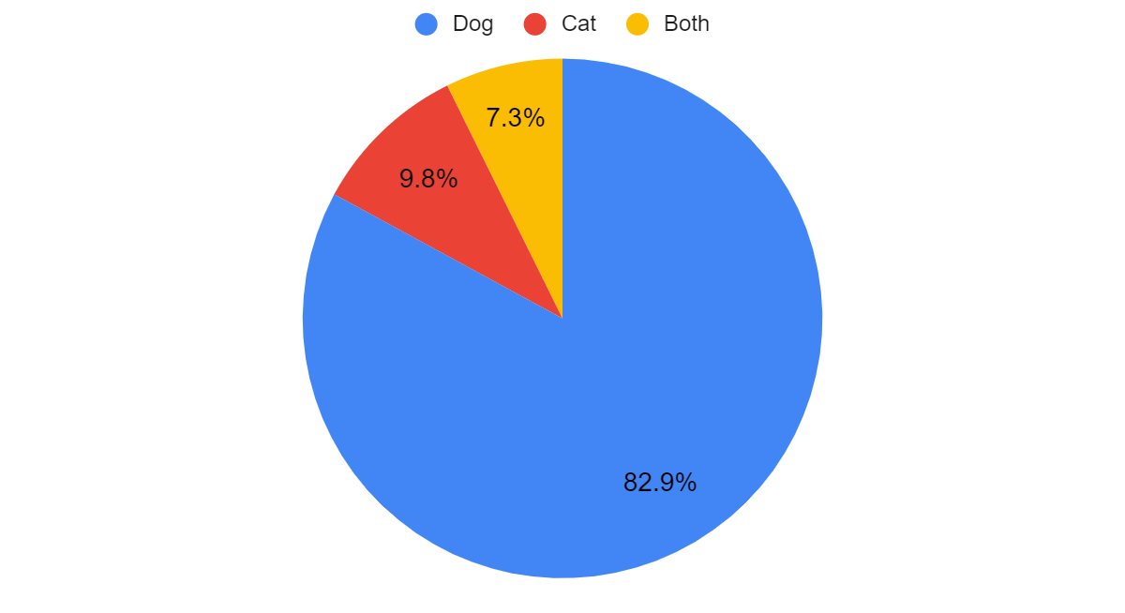
Which Pet Do You Have?
By conducting primary research, we found out that a majority of people in our city own dogs.
Notes:
Increase font n size of image

Slide 6
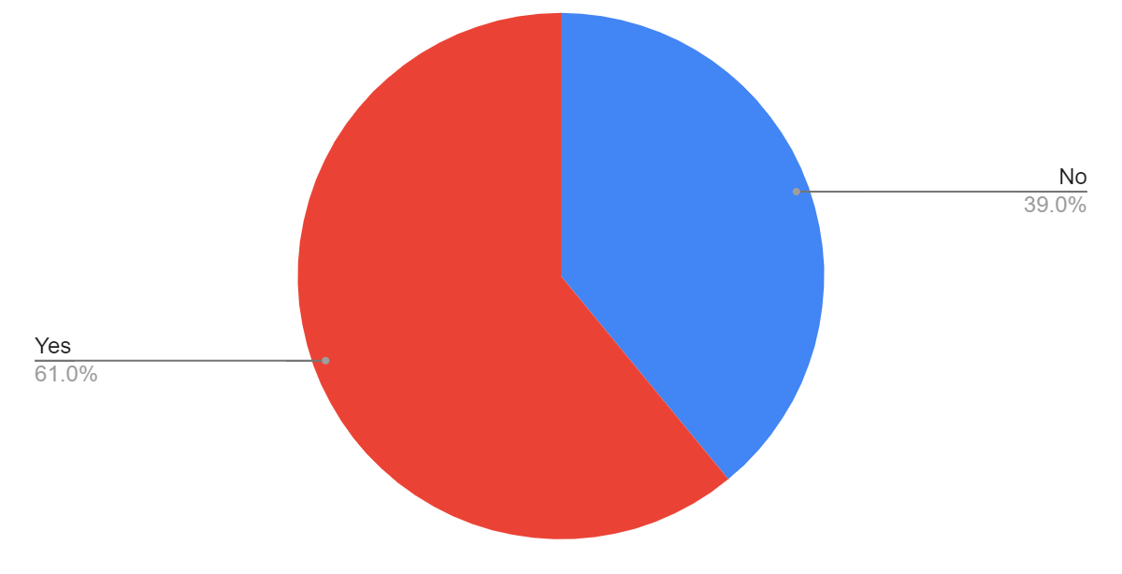
Do you find it difficult to find the right person to provide services for your pet?
We also realized that a majority of pet-owners find it difficult to find the right person to provide services for their pets.

Slide 7
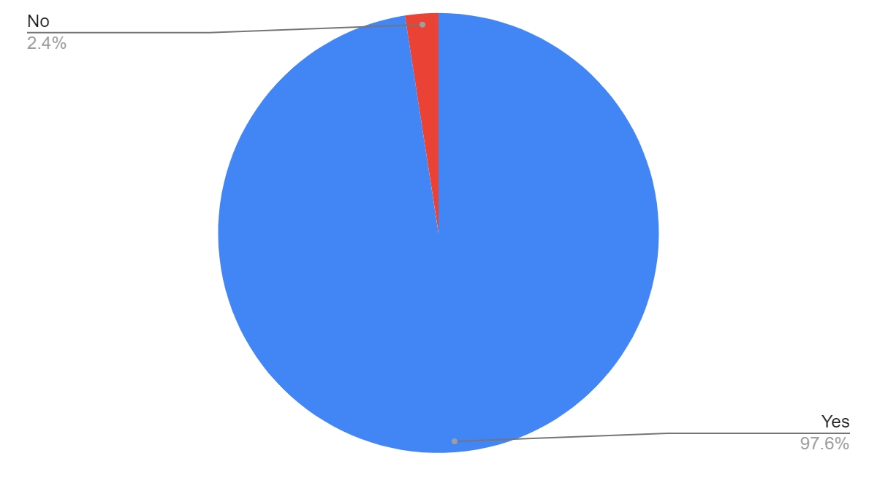
Do you feel like your home is suitable for your pet?

Slide 8
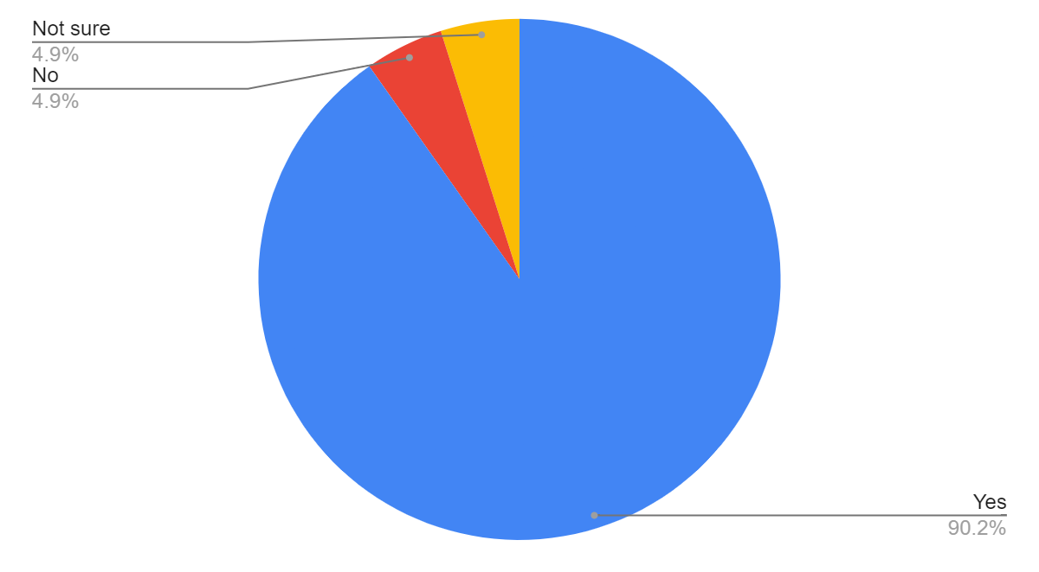
Is your pet comfortable with other people?

Slide 9
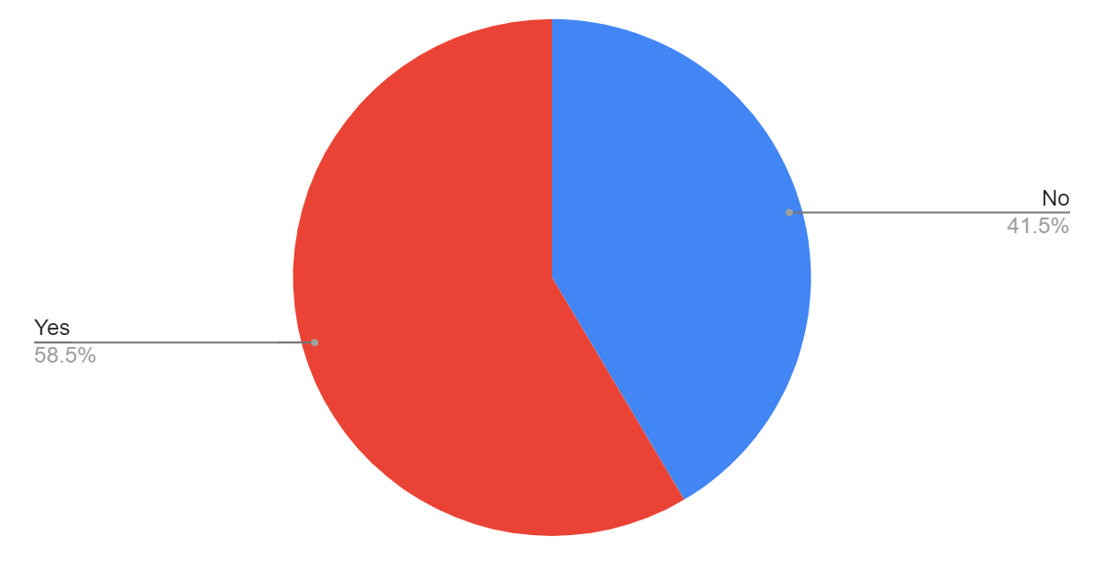
Do you find it tedious to walk, feed, or clean the litter of your pet?

Slide 10
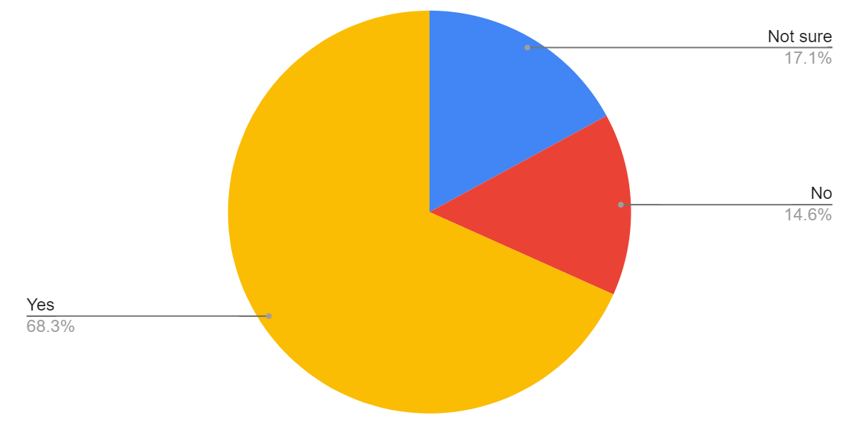
Are you comfortable with a professional pet sitter taking care of your pet at home/at your sitters home?

Slide 11
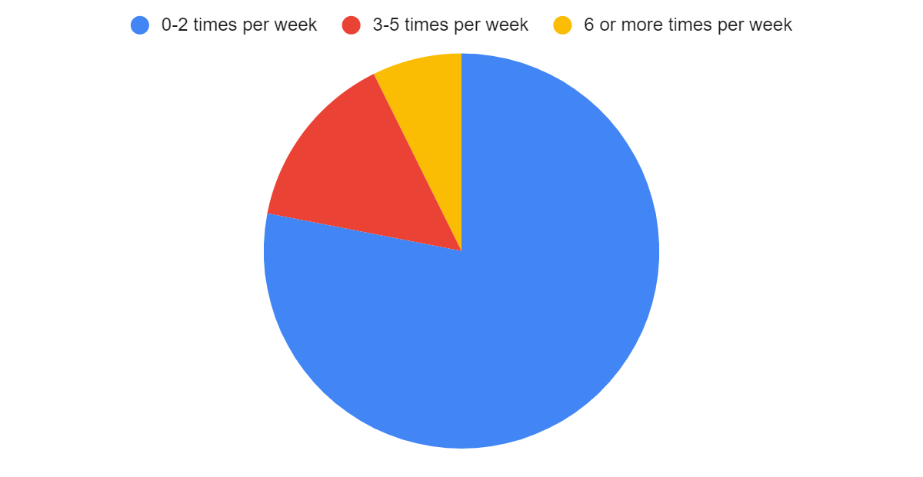
How often do you leave your pet unattended in your house?

Slide 12
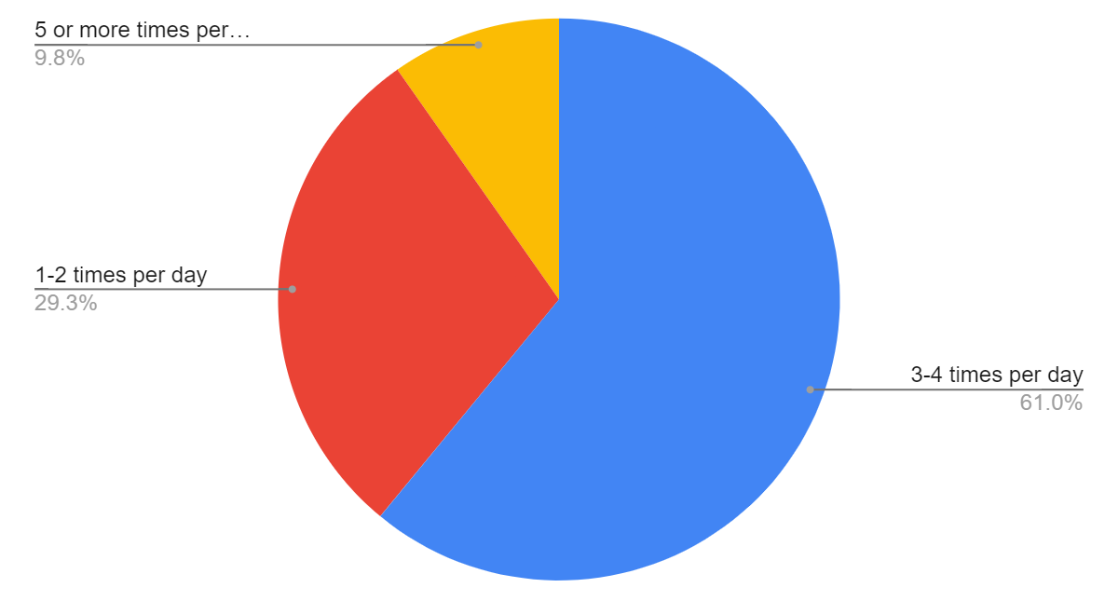
How often do you walk your pet?

Slide 13
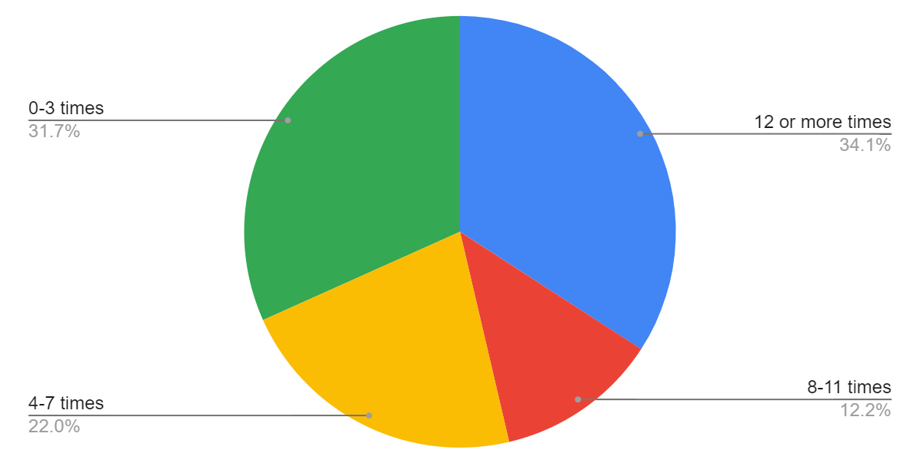
How often do you stay overnight elsewhere (away from your pet) in a year

Slide 14
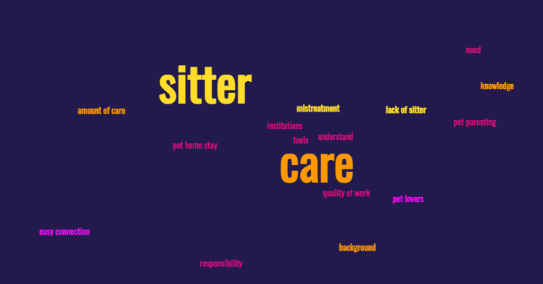
If you could, what would you change about pet sitters?
Pet Parents wanted quality services that were:
Affordable
Reliable
Easy to access
Safe
Notes:
bullet

Slide 15
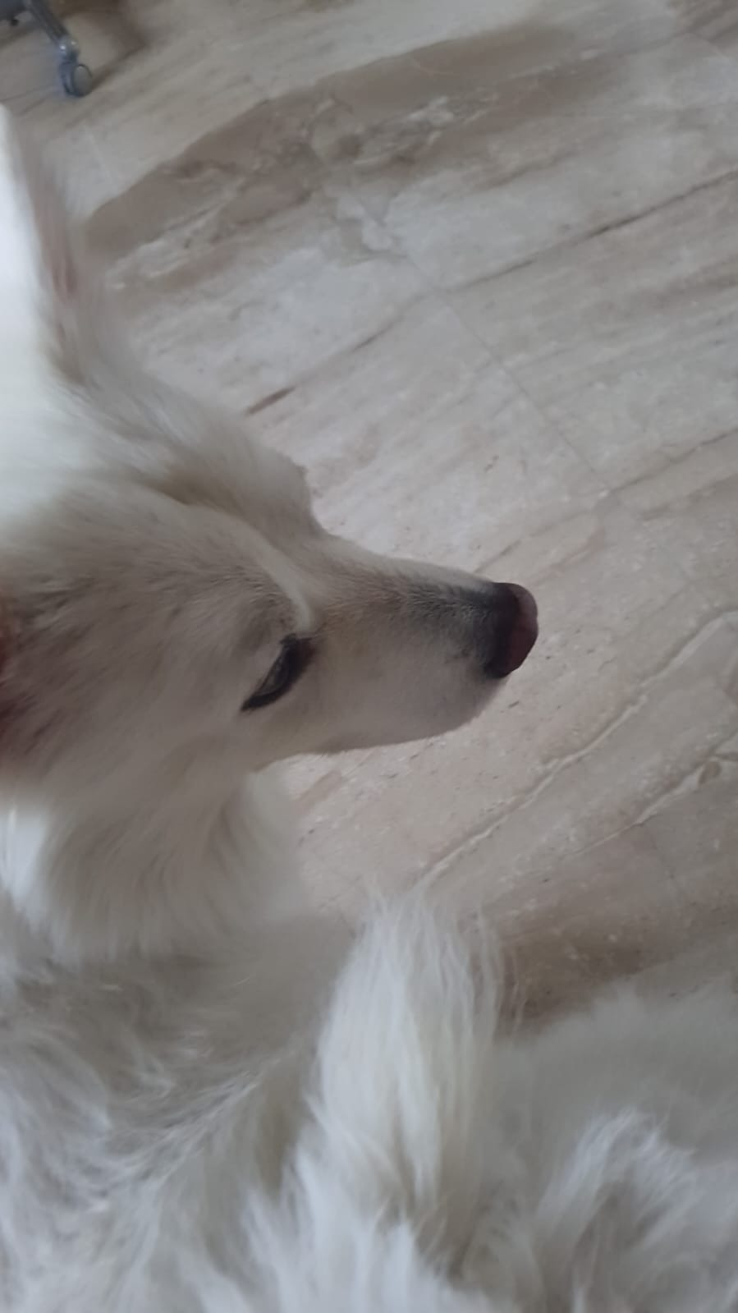
The Growing Industry

Slide 16
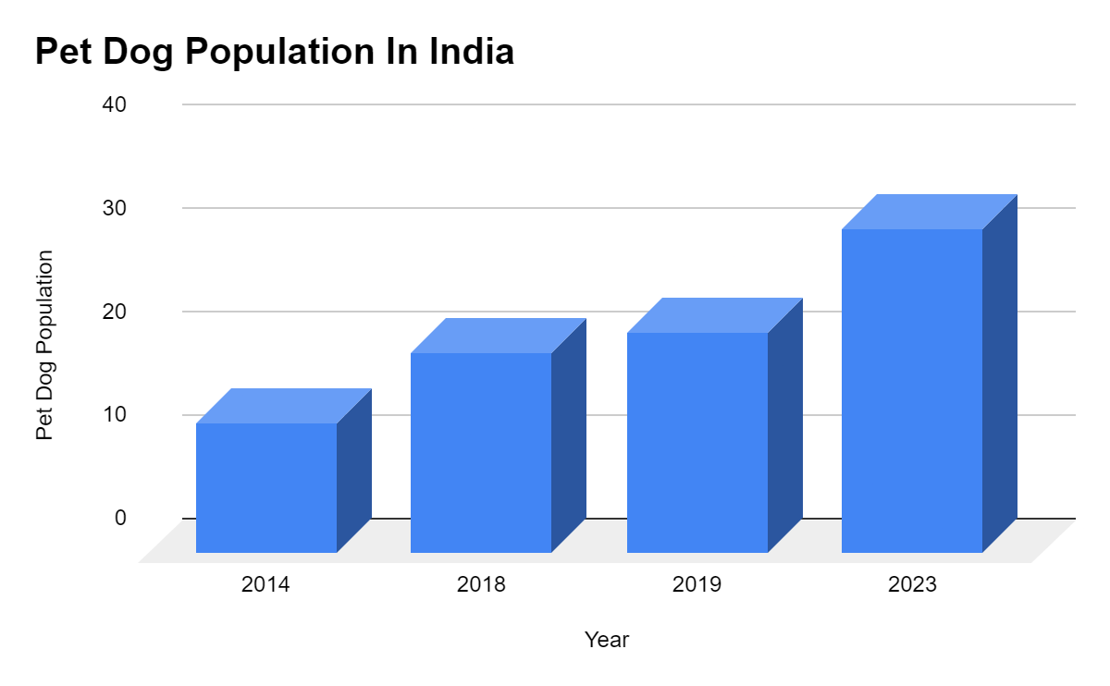
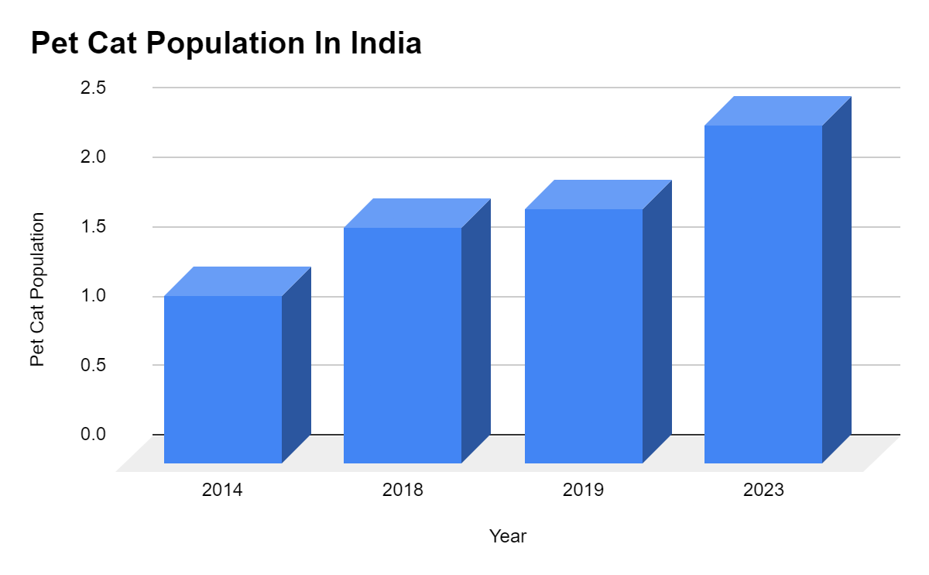
Population Graphs Of Pets In India
(million)
(million)
Growth at 11% CAGR
Growth at 8% CAGR
Between 2020-2025, The Pet Care Industry Is Expected To Grow At 14% CAGR

Slide 17

Catalysts For Growth
India Is The Fastest Growing Pet Care Market In The World, Mainly Due To The Following Reasons:
Urbanisation
Rise In Nuclear Families
Changing Perception Towards Owning Pets

Slide 18
More About PetConn

Slide 19


Value Proposition
Pet-Parents:
Accessibility
Ability to find the right sitter
Security
Service-Providers:
Earn while enjoying
Flexibility
Notes:
Less write up more bullet points

Slide 20


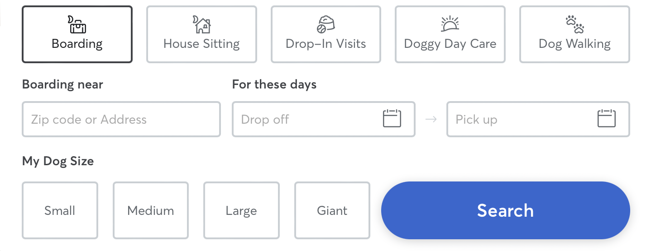

How does PetConn work?
Parents can use the various tools and the search algorithm to find the right sitter through our website. We also support in-app communication as well as payment.
Notes:
Bullet points

Slide 21

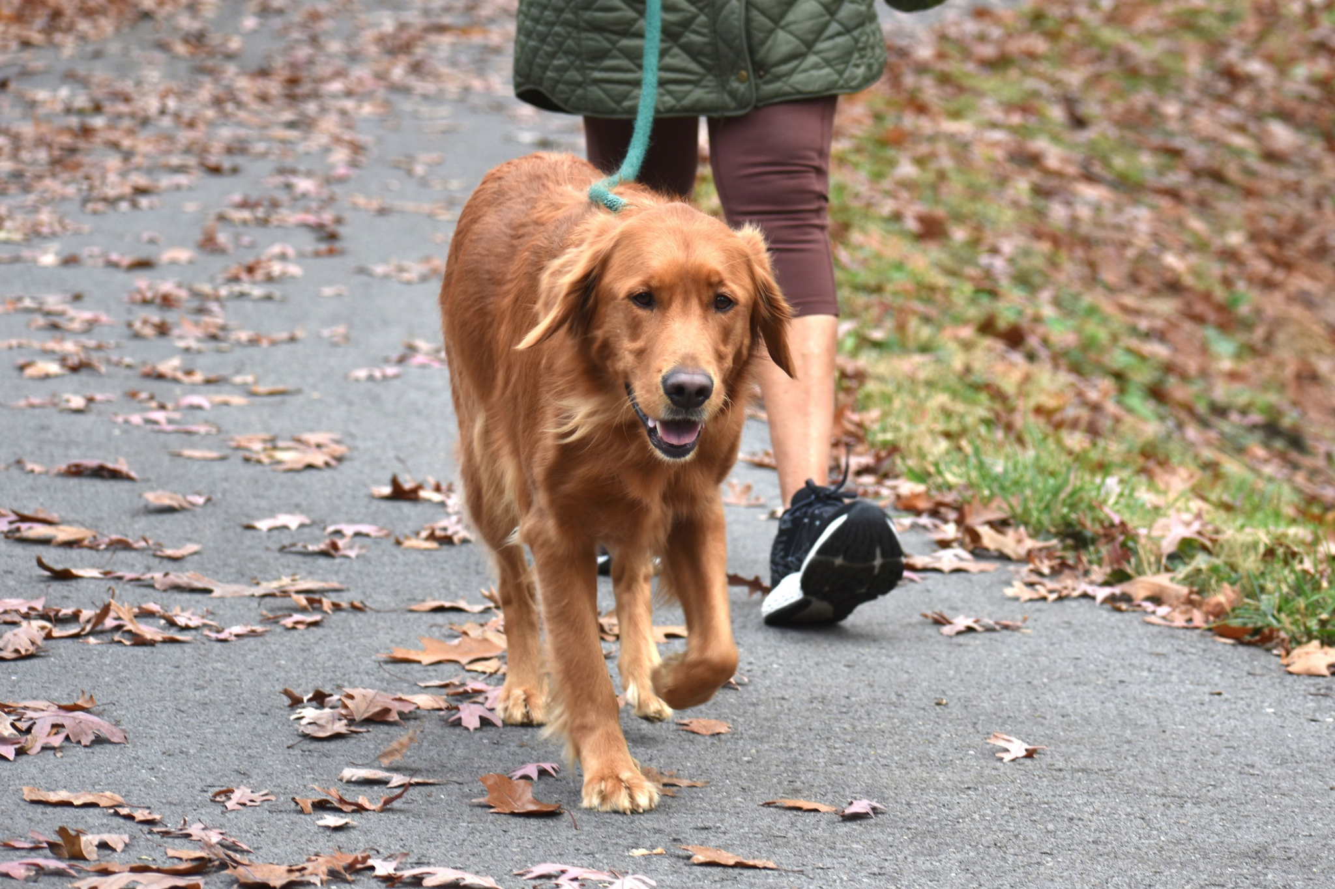
Services That Can Be Availed/Provided Through Us
Boarding
House Sitting
Dog Walking
Doggy Day Care
Drop-In Visits
Notes:
Give only headings not write ups

Slide 22


Pricing & Sources Of Income
2.5% Commission from both the sitters as well as the parents
Premium features( ProSitter, CaringParent)
Online Store (Future)

Slide 23

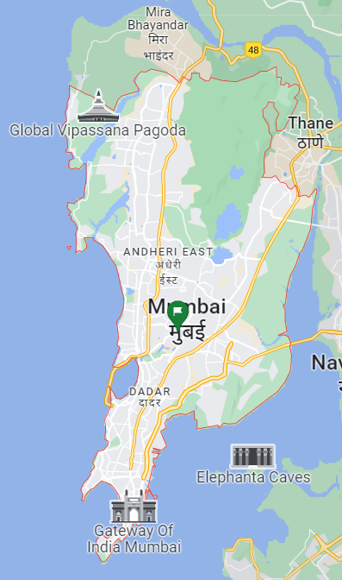
Our Location
We have chosen to start our operations in Mumbai and later expand to other cities.
Notes:
You have not worked on any suggestion. Pls add location images

Slide 24

Our TAM and Potential Customer Base
Huge TAM - there are around 275,000 dogs in Mumbai itself.
First movers advantage
We expect to take over 5% of the TAM.

Slide 25
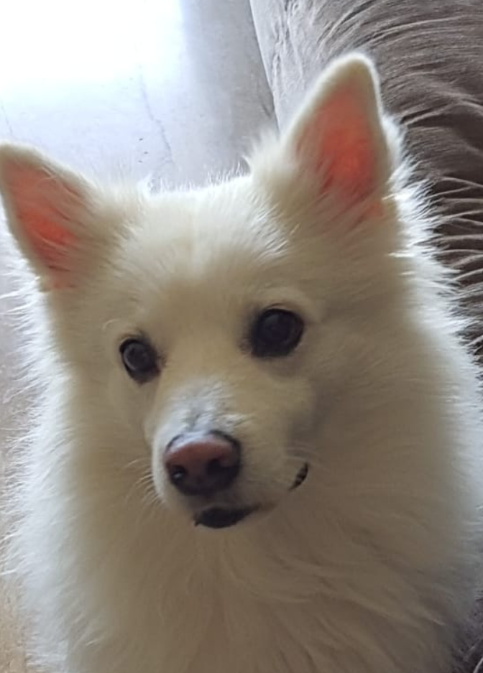
Our Promotion Strategy

Slide 26





How we will advertise our service
Target teens through social media
Media platforms provide a service in which we can advertise to our specific target audience.
Putting up posters in pet parks, veterinarian clinics, and pet grooming salons.
Notes:
Write less speak more

Slide 27


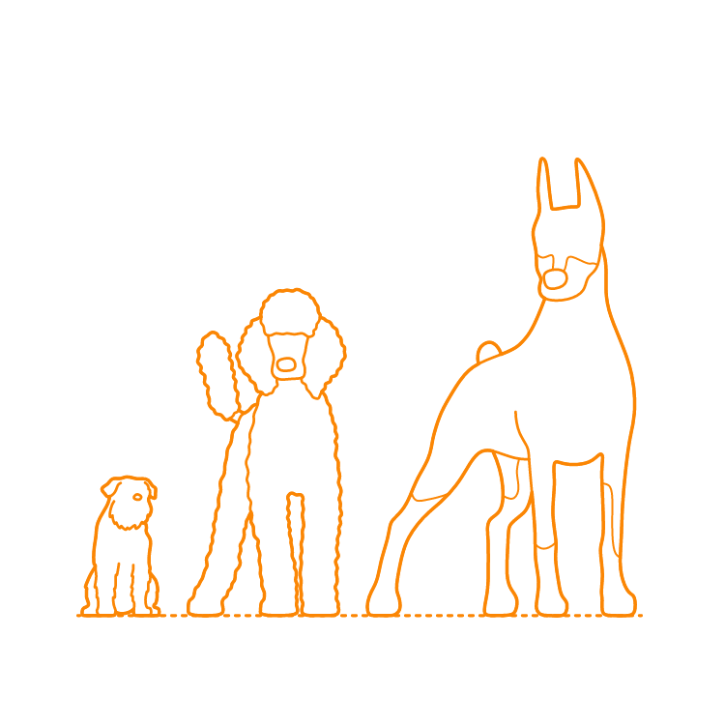

Why people will prefer our service
App and website smoothly connects pet-owners and pet-sitters.
Tools and information that help pet-owners find their desired pet-sitter and pet-sitters find their preferred clients.
Pet-Sitter
Pet-Owner

Slide 28

Why people will continue with our service
Our platform and features will help build relations and trust between pet-sitters and pet-owners, and it will keep a consistent and loyal customer platform.

Slide 29
Website & App Design

Slide 30
https://petconn.github.io

Slide 31
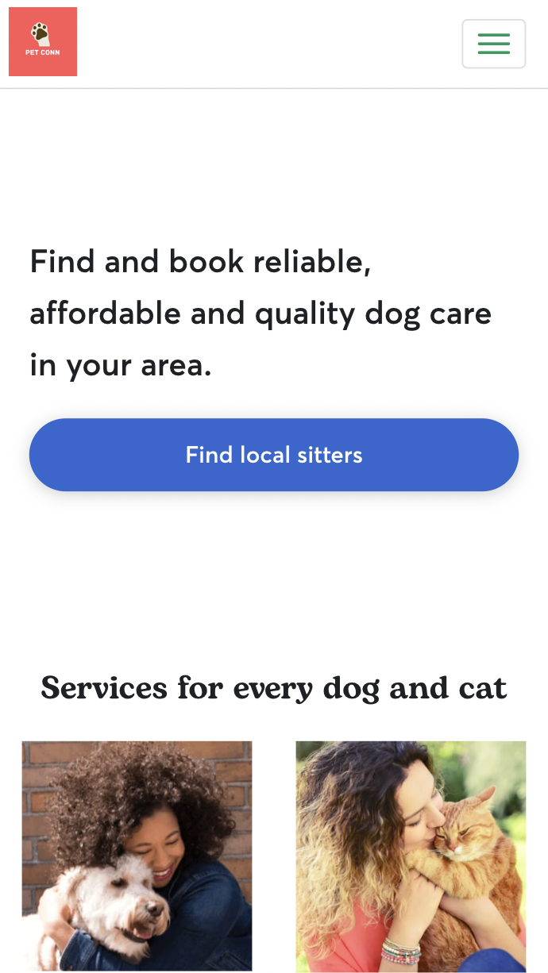
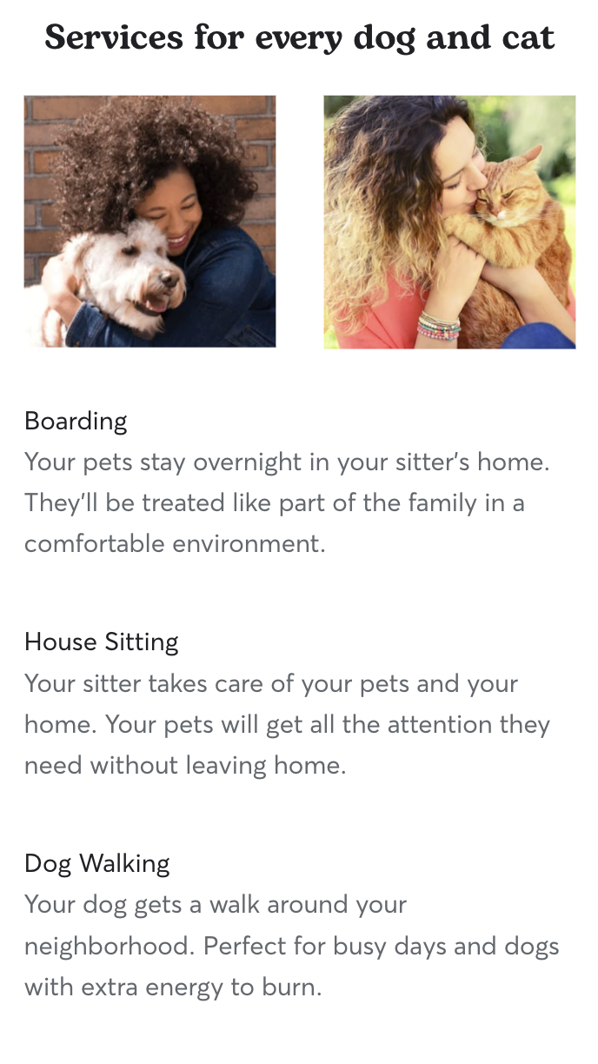
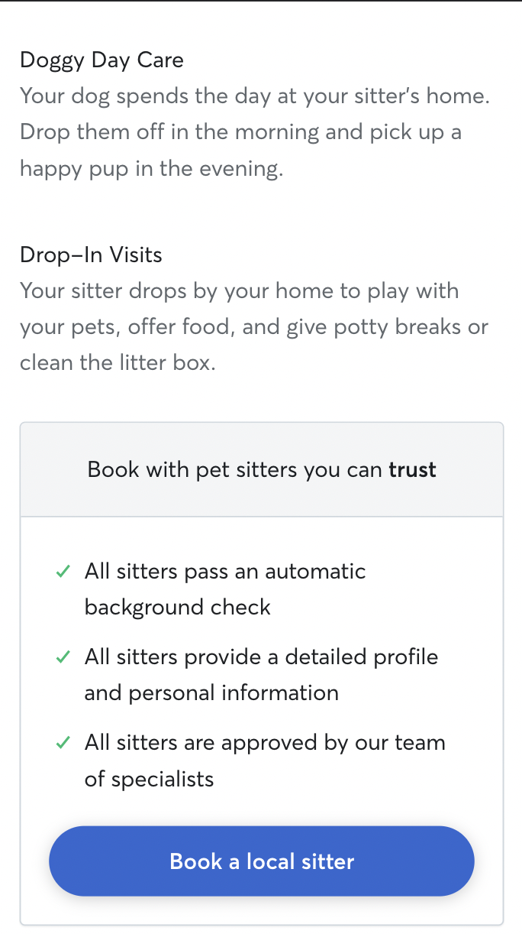

Slide 32
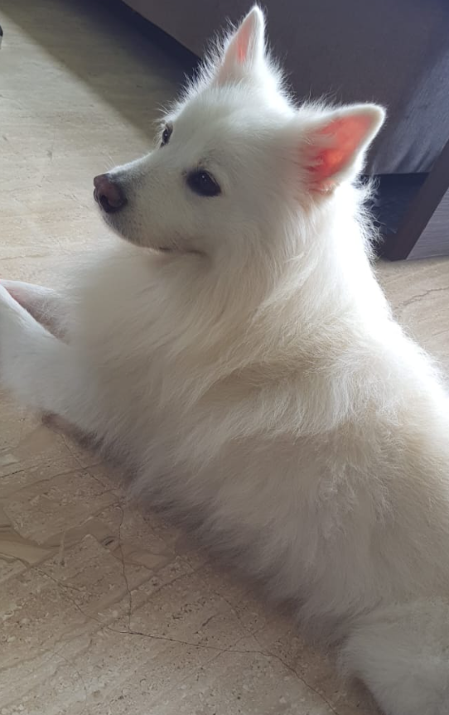
Future Financials And Valuation

Slide 33
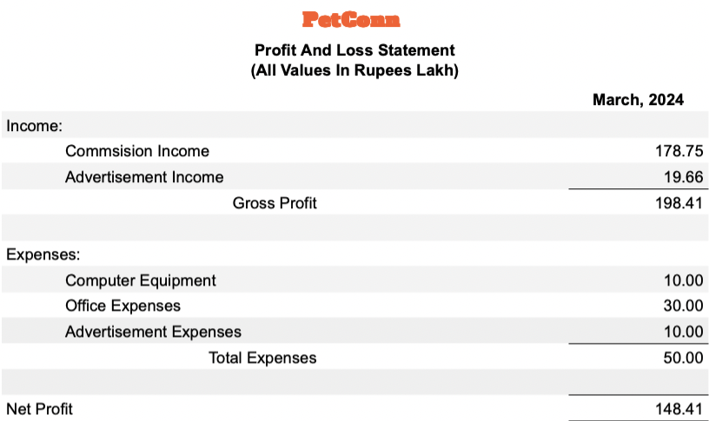
Profit And Loss Statement
Notes:
Share excel sheet

Slide 34
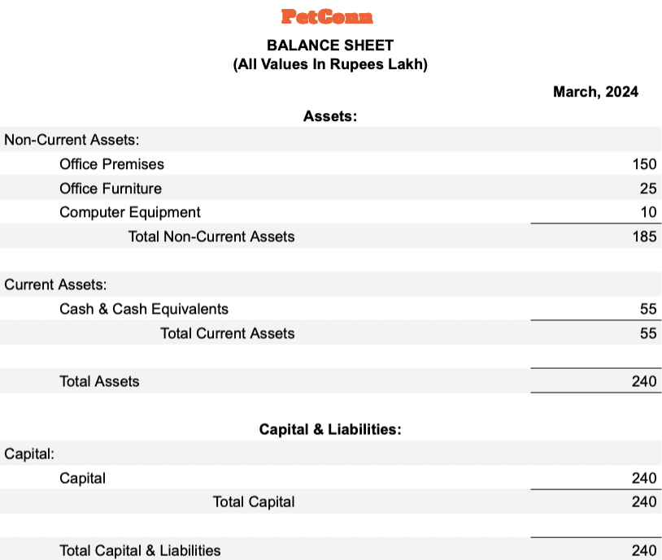
Balance Sheet
Notes:
Please share excel doc

Slide 35
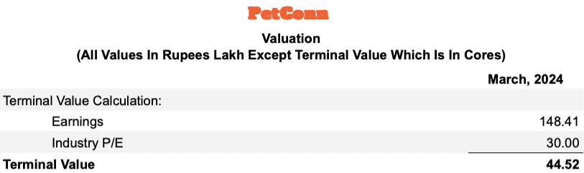
Valuation

Slide 36
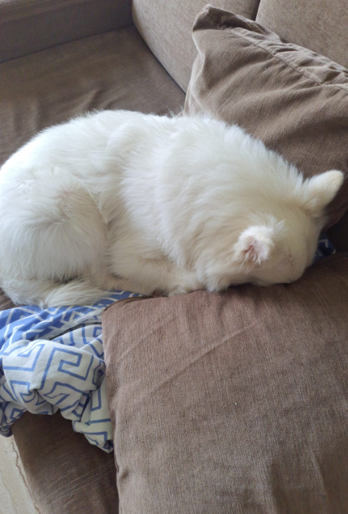
Conclusion

Slide 37


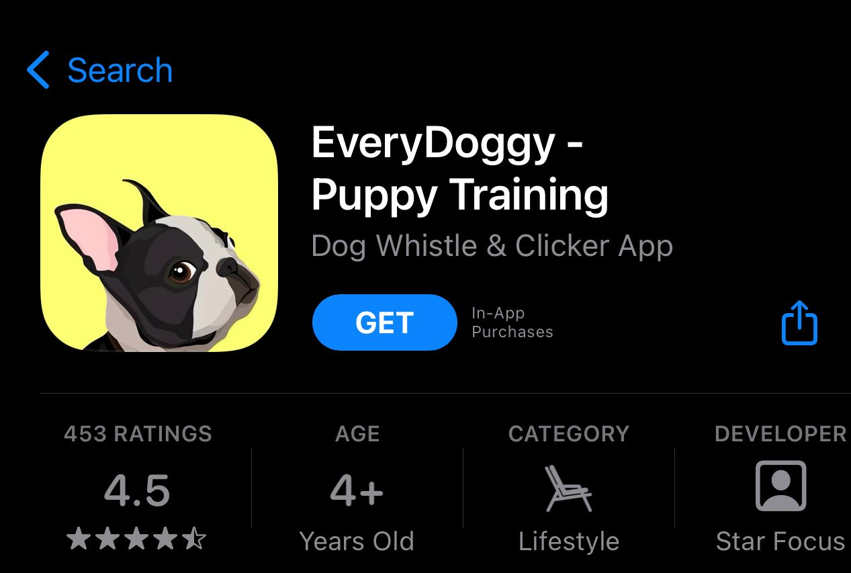
Our Learning Experience
We had an opportunity to learn about finances, market research, web and app design, and much more
Under market research, we learned about questionnaires.
Under finances, we learned about balance sheets and valuation
Under web and app design, we learned how to create a website and app.
PetConn
Connecting pet-owners to pet-sitters
PetConn
Notes:
bullets

Slide 38
Problems we faced and how we Solved them:
We couldn’t find a way to get pet-owners to answer our questionnaire. We shared our questionnaire on building pet groups, so it reached our target market.
We noticed that a small portion of our questionnaire data was tampered with. We filtered out all of the tampered data and kept relevant data.
Pet-owners were doubting the reliability of the pet-sitters.. We did background checks on pet-sitters before listing them on our app/website, and introduced a review system
We needed to have a firm customer base. We introduced features like bookmarking, recent sitters/owners, and profiles.

Slide 39
Thank You

